Slide 1
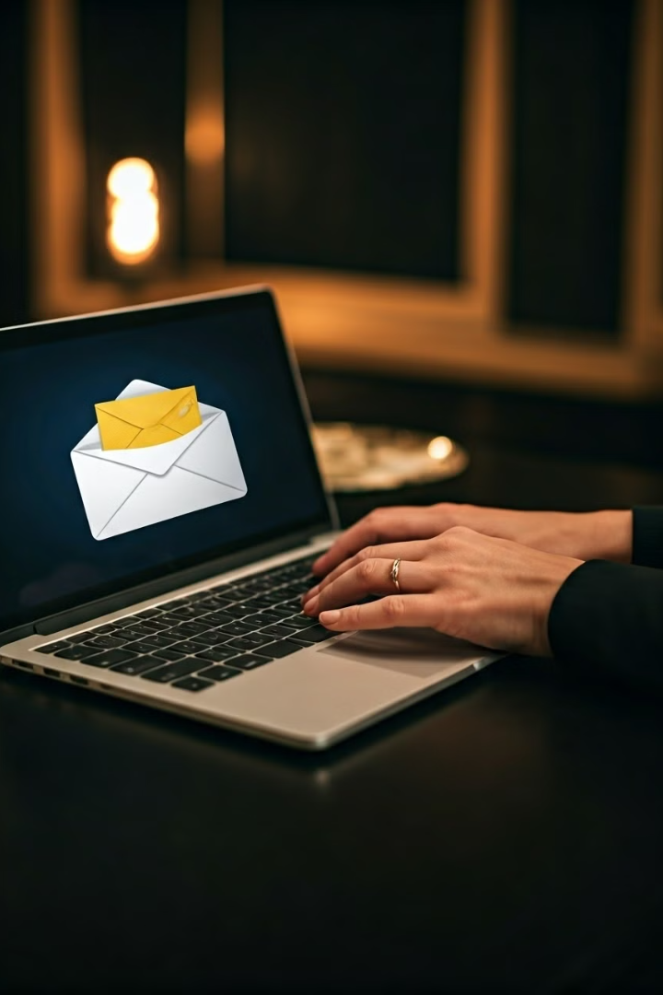
Phishing Awareness Training
In today's digital landscape, phishing attacks have become a prevalent threat to businesses and individuals alike. This training module is designed to equip you with the knowledge and skills necessary to recognize, avoid, and report phishing attempts, empowering you to stay safe in the online world.
Tatavolu Sai Viswanadh

Slide 2

What is Phishing?
Definition
Objectives
Phishing is a type of social engineering attack where malicious actors attempt to lure victims into revealing sensitive information, such as login credentials, financial data, or other personal details. Phishers often impersonate legitimate organizations or individuals to gain the trust of their targets.
The primary goals of phishing attacks are to steal sensitive information, install malware, or gain unauthorized access to systems and networks. Phishers can then use this information to commit identity theft, financial fraud, or further cyber attacks.

Slide 3

Common Phishing Tactics
1
Impersonation
Phishers often impersonate trusted organizations, such as banks, government agencies, or well-known companies, in an attempt to appear legitimate and gain the victim's trust.
2
Urgent Requests
Phishing emails may create a sense of urgency, such as threatening account closure or legal action, to pressure the victim into taking immediate action without proper verification.
3
Fake Offers
Phishers may offer enticing deals, prizes, or job opportunities to lure victims into providing personal information or clicking on malicious links.
4
Malicious Attachments
Phishing emails may contain attachments that, when opened, can install malware or give the attacker access to the victim's device or network.

Slide 4

Spotting Phishing Emails
Sender Address
Spelling and Grammar
Closely examine the email sender's address, as phishers often use domain names that are similar to legitimate organizations but with small variations.
Phishing emails may contain numerous spelling and grammatical errors, as they are often hastily crafted or translated from other languages.
Urgency and Threats
Unexpected Requests
Be wary of emails that create a sense of urgency or threaten immediate consequences, such as account closure or legal action, if you do not take immediate action.
Legitimate organizations will not typically ask for sensitive information, such as login credentials or financial information, via unsolicited email.

Slide 5
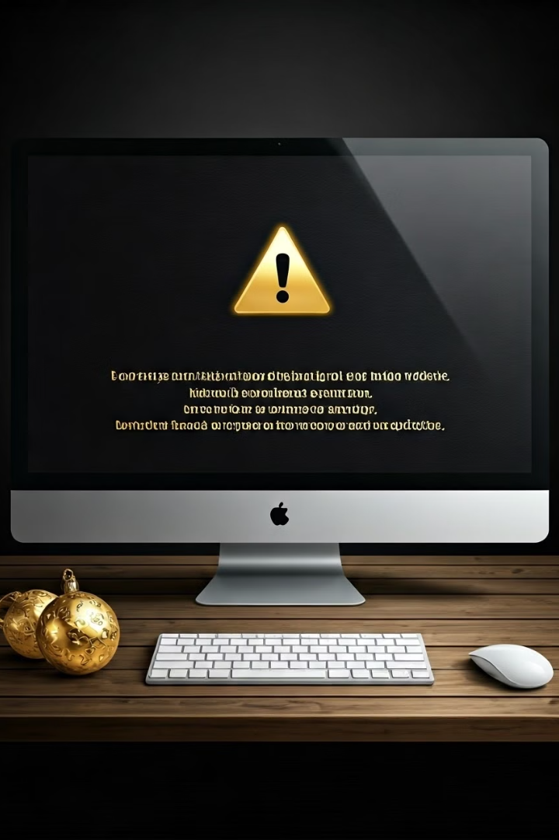




Identifying Suspicious Websites
URL Inspection
SSL/TLS Verification
Website Reputation
Carefully examine the URL of any website you are directed to, as phishers often use domain names that are similar to legitimate websites but with small variations.
Ensure that any website you visit uses a secure HTTPS connection, as this indicates the website is using encryption to protect your data.
Research the website's reputation and history, as phishing sites are often newly created and lack a substantial online presence.
Trusted Certificates
Verify that the website's SSL/TLS certificate is issued by a trusted Certificate Authority, as phishing sites may use self-signed or fraudulent certificates.

Slide 6





Social Engineering Tricks
Emotional Appeals
Impersonation
Phishers may use fear, curiosity, or a sense of urgency to manipulate victims into taking actions that compromise their security.
Phishers may impersonate trusted individuals, such as IT support staff or company executives, to gain the victim's trust and extract sensitive information.
2
1
Tailored Messaging
Phishers may conduct research on their targets to personalize their attacks, making them appear more credible and convincing.
3
Persistence
5
Phishers may attempt multiple attacks, using different tactics, to wear down their victims and increase the chances of a successful breach.
4
Exploiting Vulnerabilities
Phishers may take advantage of human biases, such as the desire to be helpful or the fear of consequences, to influence their victims.

Slide 7

Protecting Yourself from Phishing
Be Vigilant
Develop a critical eye for suspicious emails, websites, and social interactions. Always verify the legitimacy of any request for sensitive information.
Use Strong Passwords
Ensure that your login credentials are strong and unique, and consider using a password manager to generate and store them securely.
Enable Two-Factor Authentication
Activate two-factor authentication (2FA) on all of your accounts to add an extra layer of security and prevent unauthorized access.
Keep Software Updated
Regularly update your devices and software to ensure you have the latest security patches and protections against known vulnerabilities.

Slide 8





Reporting Suspected Phishing Attempts
Identify the Threat
Carefully examine any suspicious emails, messages, or websites to determine if they are likely phishing attempts.
Document the Evidence
Capture screenshots, email headers, and other relevant information that can be used to report the phishing attempt.
Report to the Proper Authorities
Notify your organization's IT or security team, as well as any affected companies or government agencies, to help them investigate and mitigate the threat.
Spread Awareness
Share your experience and the details of the phishing attempt with your colleagues and others in your network to help them stay vigilant.

Slide 9





Phishing Prevention Best Practices
Implement
Educate
Deploy robust cybersecurity measures, such as email filters, web content blockers, and multi-factor authentication, to protect your organization.
Provide regular training and awareness campaigns to help your employees identify and avoid phishing attempts.
2
1
Simulate
Conduct phishing simulation exercises to test your employees' ability to recognize and report suspicious activities.
3
5
Adapt
Report
Continuously review and update your phishing prevention strategies to stay ahead of evolving threats and tactics.
4
Encourage a culture of vigilance and transparency, where employees feel empowered to report any suspected phishing attempts.

Slide 10

Conclusion and Key Takeaways
1
Recognize Phishing Tactics
Understand the common techniques used by phishers, such as impersonation, urgent requests, and malicious attachments, to avoid falling victim to their schemes.
2
Verify Legitimacy
Carefully examine the sender's address, URLs, and other details to ensure the authenticity of any requests for sensitive information.
3
Protect Yourself
Implement strong security measures, such as using unique passwords, enabling two-factor authentication, and keeping your software up to date.
4
Report and Share
Promptly report any suspected phishing attempts to the appropriate authorities and share your experiences to help others stay informed and vigilant.

